Slide 1

Learning with Augmented Reality
Team Members: Jeffrey Perez, Luis Perera Product Owner: Shahin Vassigh
Instructor: Masoud Sadjadi School of Computing and Information Sciences Florida International University
Final Presentation
Spring 2017
Notes:
7 seconds.( I will select 2 best slides (i will give them extra points and students will present for CIS committee)
Greet your audience, thank them for attending your presentation, introduce yourself, introduce your project, introduce your team members, and quickly indicate what each of you did in a high-level manner, and put more emphasis on your part/contribution.

Slide 2
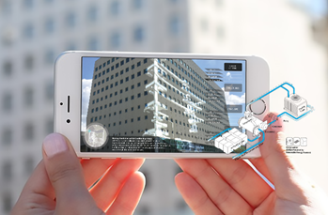
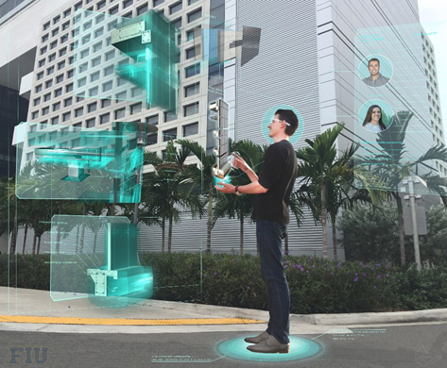
Project definition
Notes:
10 seconds.
Introduce the problem that the whole project (in all versions) tackles with GIF or screenshot.

Slide 3
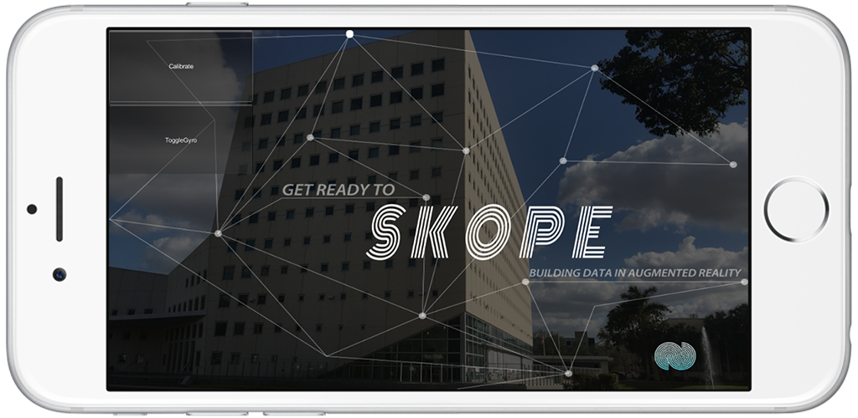
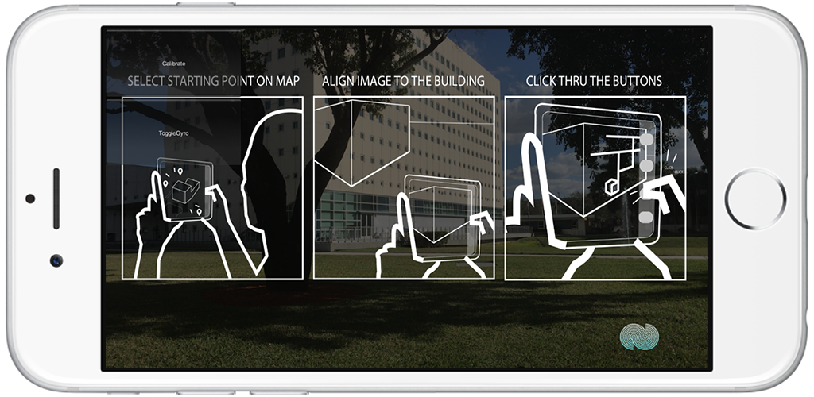
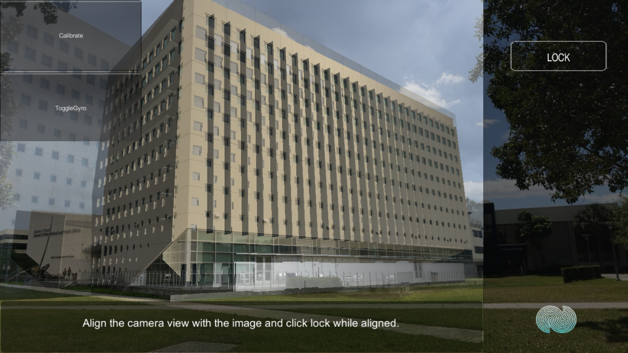
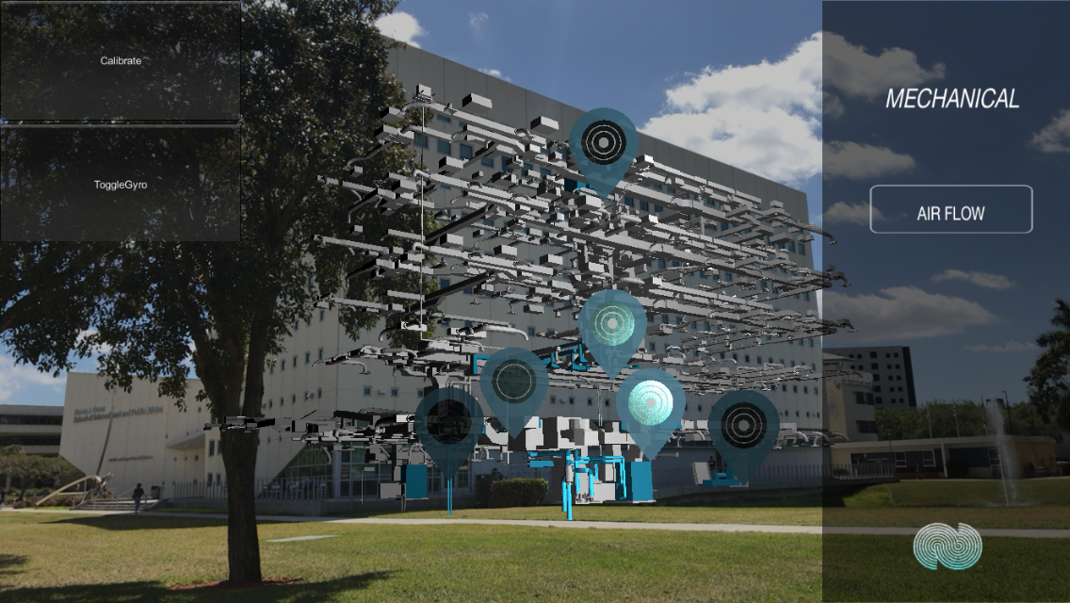
Project definition
Entry to application
Simple user instructions
Lock and align the image with the SIPA building
Touch icons to interact
Notes:
20 seconds.
Introduce the problem that the your project (in new version) tackles with GIF or screenshot.

Slide 4
Problem definition
How to make students to learn when using this application?
How to implement different behaviors in the SKOPE-AR application depending on the user interaction ?
How to create an user compliance SKOPE-AR application for Android and iOS deployment?
Notes:
10 seconds.
Introduce the problem that the whole project (in all versions) tackles with GIF or screenshot.

Slide 5
Requirements: Use Cases
Notes:
5 seconds
Show the Use Case Diagram for the whole project. Highlight your use cases.

Slide 6
System Design: Architecture
Allow users to pick up a point or position around the building from where they want to start.
Navigate through panels displaying options to select as well as descriptions of the model.
Pause and play recording of the rear camera.
Activate/Deactivate the gyroscope of the device.
Reproduce a video for some parts of the model.
Implement video player in the SKOPE-VR as it is also part of the SKOPE project.
Upload the application to the App and Play Store.
Notes:
20 seconds
System design: Highlight the parts that you contributed to them.
1. System decomposition; identify the architecture patterns used
2. System deployment – h/w and s/w requirements

Slide 7
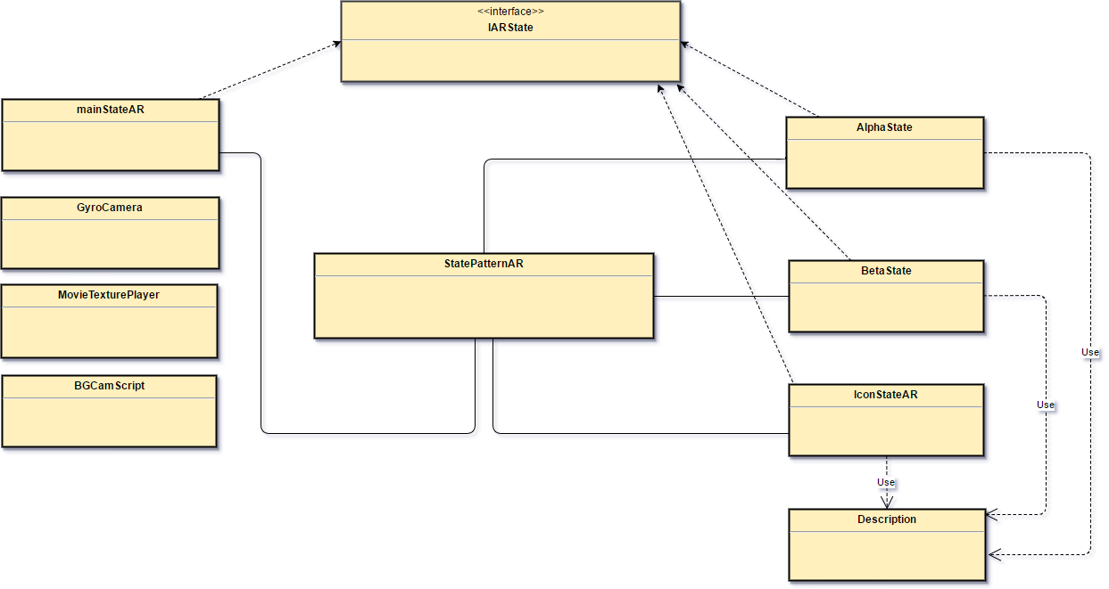
Minimal Class Diagram
Notes:
10 seconds.Minimal class diagram. Highlight the classes that you created/modified
Identify the design patterns used (one or more slides).

Slide 8
Main Algorithms
Populate Dictionary:
Start application.
Read next line of “TitleDescription.txt“, if EOF go to 6
Split the line read with =, where the left part to = will be the key and the right part the description.
Insert key and description to the dictionary.
Go to step 2.
Finish
Set Description:
Get the current platform (iOS, Android, Unity).
Depending on what platform the user is, get where the user touched/clicked.
If an icon was touched, move the AR camera to that icon, otherwise go to 5.
Set the description of that part of the model by getting the instance of Description and calling the setDescription method with the name of the panel as parameter.
Finish

Slide 9
State Machine
Alpha State
Icon StateAR
MainStateAR
BetaState
Icon StateAR

Slide 10
User Stories
1. #188 – SKOPE AR State Machine for UI
2. #187 – SKOPE AR User Interface Navigation
3. #190 – SKOPE AR Upload for Android
4. #192 – SKOPE AR Upload for iOS
5. #199 – SKOPE AR Movie Player
Notes:
5 seconds.
List the user stories that you worked on them.(put in order of importance). Stay focused on the parts that you have been working.

Slide 11
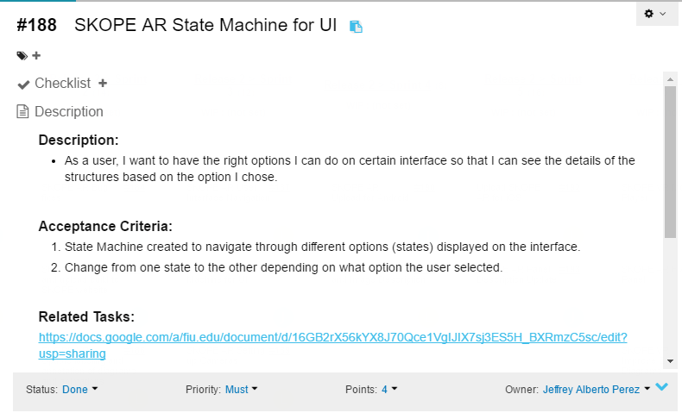
User Story #1
Notes:
20 seconds
The tile of user story
Please present and show the complexity of your work, code, algorithms, and technical challenges and technologies you have used. (you could use screenshot if you want. Visual presentations are better than text presentation) - Go into the details of the most important/significant tasks using bullet lists or visual graphs or state chart diagram - Demo using screenshots or GIF (in another separate page if required)
Sequence Diagram for this user story is optional

Slide 12
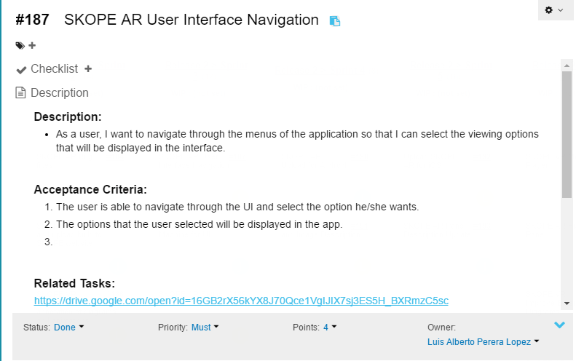
User Story #2
Notes:
60 seconds
The tile of user story
The most important user story you worked on it. You have to describe this one very well and be proud of that.
Please present and show the complexity of your work, code, algorithms, and technical challenges and technologies you have used. (you could use screenshot if you want. Visual presentations are better than text presentation)
Go into the details of the most important/significant tasks using bullet lists or visual graphs or state chart diagram
Sequence Diagram for this user story is mandatory (in another separate page if required)
Demo using screenshots or GIF (in another separate page if required)

Slide 13
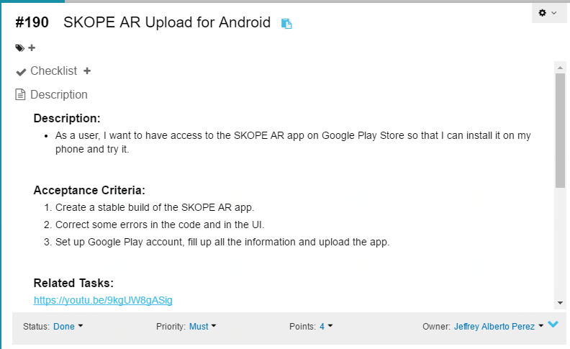
User Story #3
Notes:
20 seconds
The tile of user story
Please present and show the complexity of your work, code, algorithms, and technical challenges and technologies you have used. (you could use screenshot if you want. Visual presentations are better than text presentation) - Go into the details of the most important/significant tasks using bullet lists or visual graphs or state chart diagram - Demo using screenshots or GIF (in another separate page if required)
Sequence Diagram for this user story is optional

Slide 14
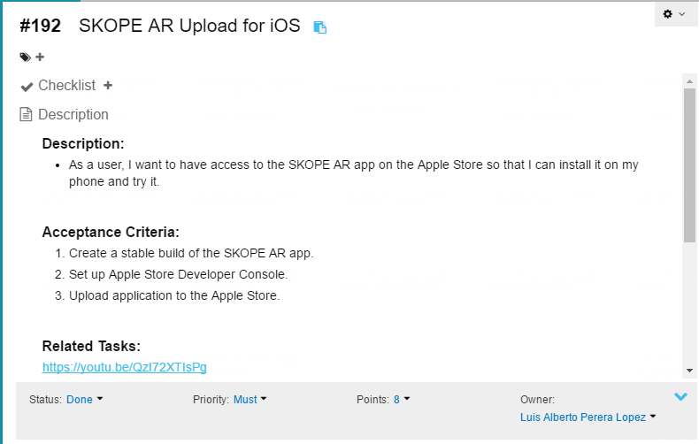
User Story #4
Notes:
20 seconds
The tile of user story
Please present and show the complexity of your work, code, algorithms, and technical challenges and technologies you have used. (you could use screenshot if you want. Visual presentations are better than text presentation) - Go into the details of the most important/significant tasks using bullet lists or visual graphs or state chart diagram - Demo using screenshots or GIF (in another separate page if required)
Sequence Diagram for this user story is optional

Slide 15
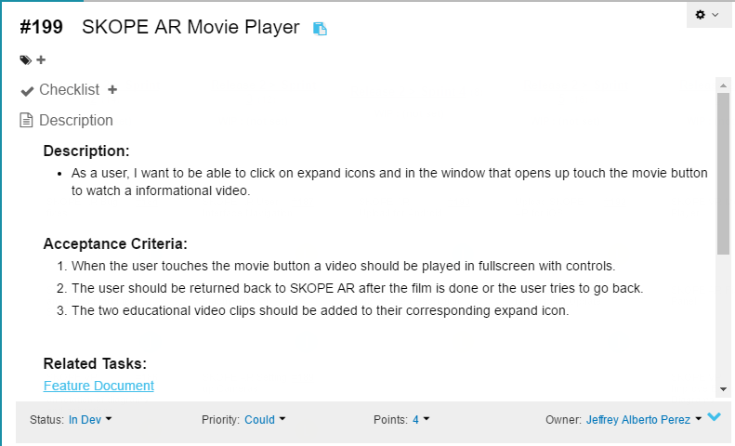
User Story #5
Notes:
20 seconds
The tile of user story
Please present and show the complexity of your work, code, algorithms, and technical challenges and technologies you have used. (you could use screenshot if you want. Visual presentations are better than text presentation) - Go into the details of the most important/significant tasks using bullet lists or visual graphs or state chart diagram - Demo using screenshots or GIF (in another separate page if required)
Sequence Diagram for this user story is optional

Slide 16



Summary
In this project we added functionalities to make a smooth interaction between the application and the users. Descriptions, images and videos were added to the model to enhance the learning process. To make it accessible, a final build of the application was uploaded to the App and Play Store. Mingle website was used to keep track of our process. All documents we’ve written have been stored on Google Drive, and the source code on Github.
Contact information
Jeffrey Perez: jpere610@fiu.edu
Luis Perera: lpere371@fiu.edu
Notes:
10 seconds
Summarize your contribution, mention your effort for Scrum, Mingle, Github, Google Drive Documentation and minutes
Include your contact information
Ask if anyone has any questions for you.
Thank your audience

Slide 17
Test Suites and Test Cases
Test Case ID | UT_DESC_001
Purpose | Verify that the dictionary is populated with the right data
Preconditions | File with description and name of the panel must exist
Input | Address of the description file
Expect Output | Dictionary is populated with the data
Test Case ID | UT_DESC_002
Purpose | Verify that the description is properly set to the panel
Preconditions | User is in the IconState and dictionary is populated
Input | User touches the Diagram button
Expect Output | Description of the panel is properly set according its name
Notes:
10 seconds
A description of verification process and Test Suites and Test Cases for one of the use cases.
1 One sunny day and one rainy day for the implemented use cases (one or more slides).
2 Automated test scripts for the implemented use cases (if any) (one or more slides).

Slide 18
Test Suites and Test Cases
Test Case ID | ST_SUNNY_DESC_001
Purpose | Verify that the description is properly set to the panel
Preconditions | User clicked an icon of the model
Input | User touches Diagram button
Expect Output | Description of the panel is properly set according its name
Test Case ID | ST_RAINY_DESC_002
Purpose | Verify that the description is not set to the panel
Preconditions | User clicked an icon of the model
Input | User touches Movie button
Expect Output | Video starts playing and no description was set.
Notes:
10 seconds
A description of verification process and Test Suites and Test Cases for one of the use cases.
1 One sunny day and one rainy day for the implemented use cases (one or more slides).
2 Automated test scripts for the implemented use cases (if any) (one or more slides).

Slide 19
Questions?

Slide 20
Thank you!

